Slide 1
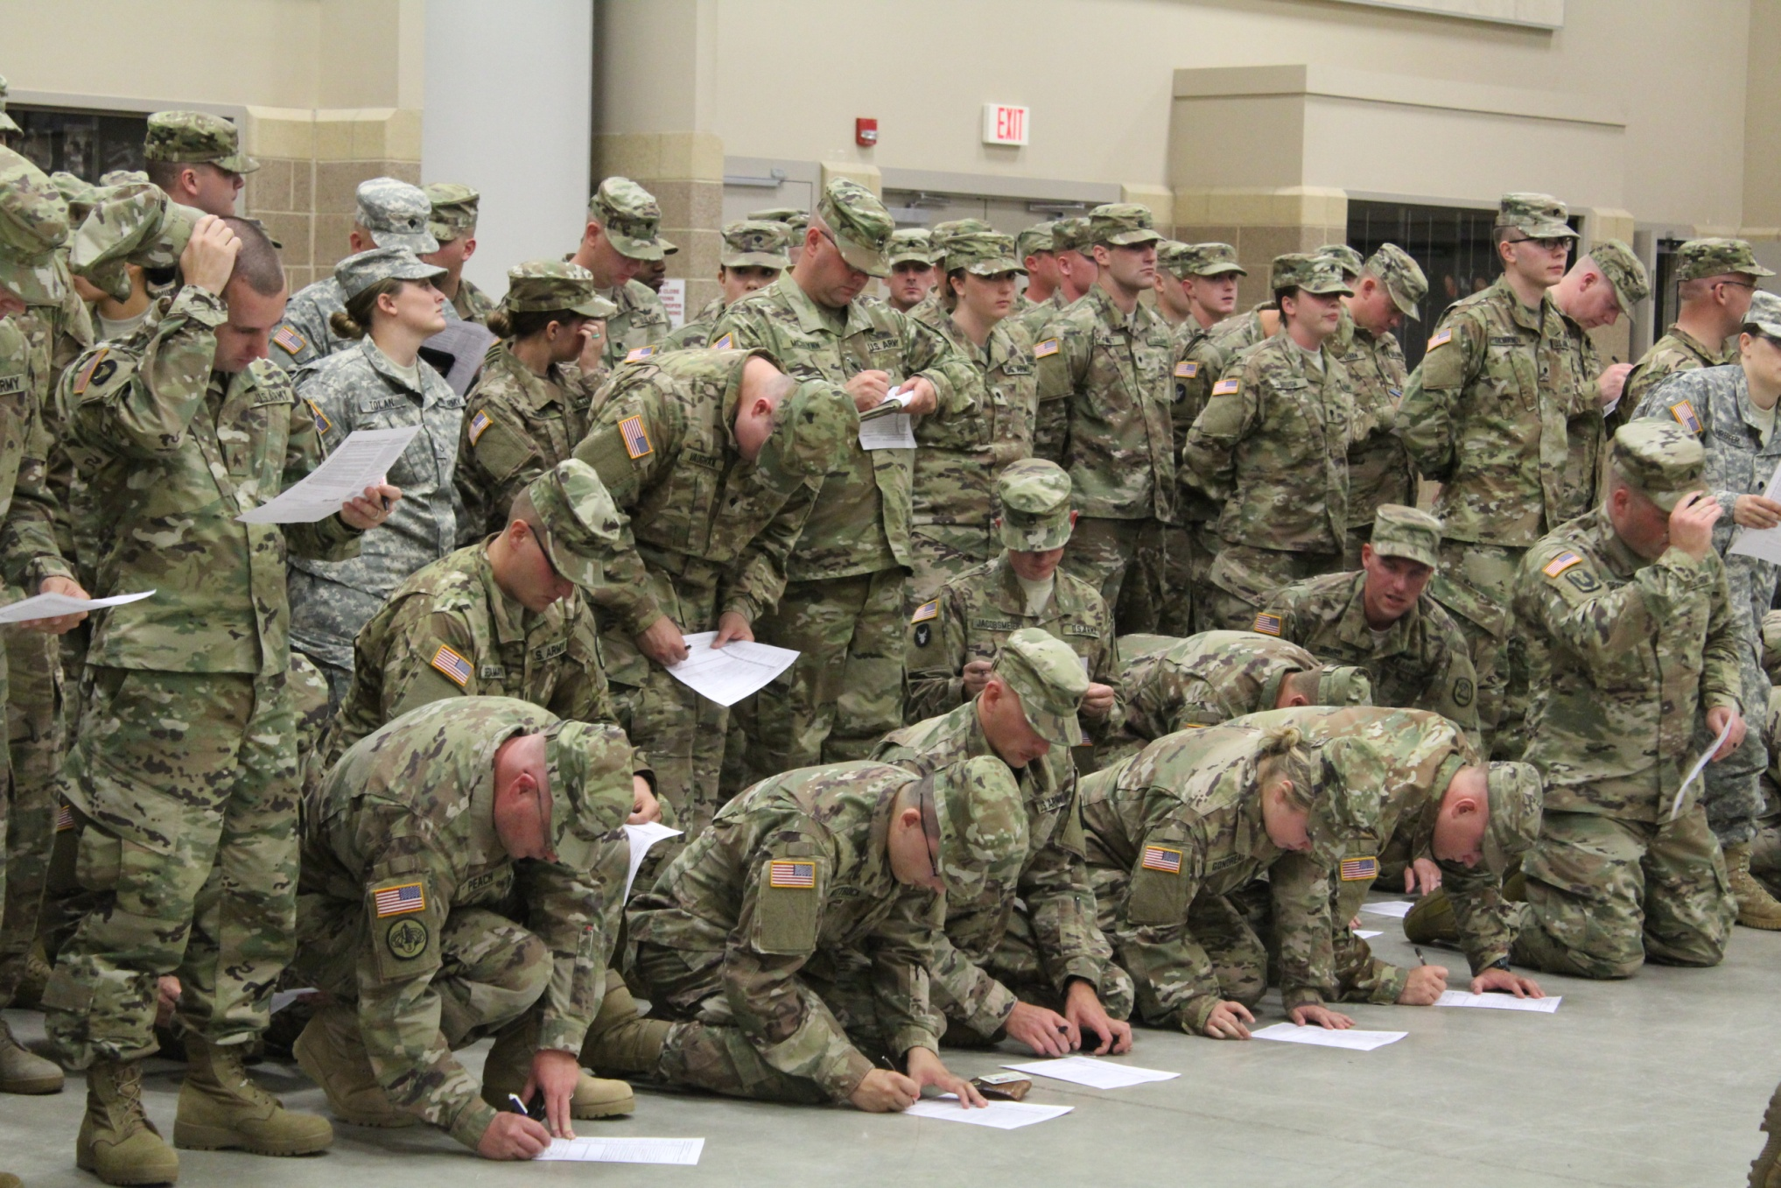

Slide 3
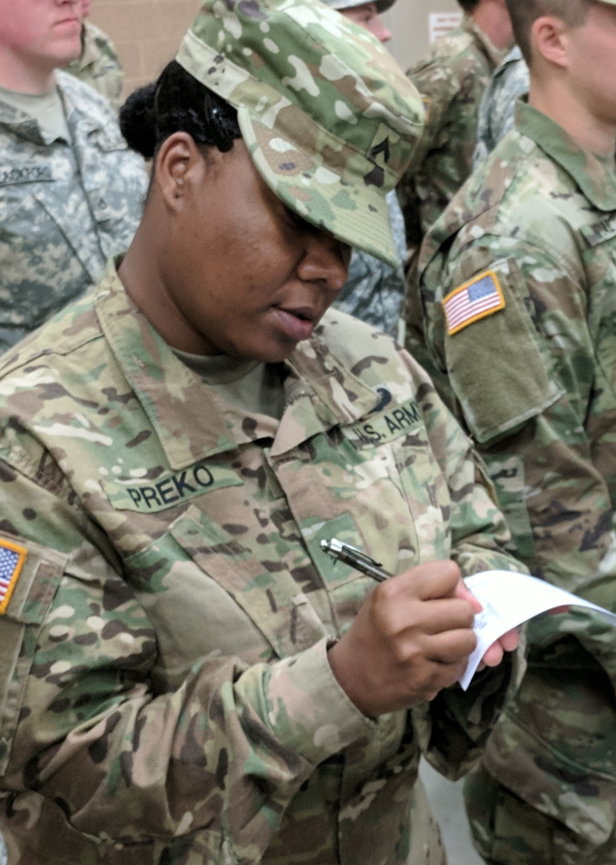

Slide 4
Helping veterans and Iowans with disabilities VOTE Hon. Paul pate Iowa secretary of state

